Slide 1





TRANSFER
From account
Select
To account
Select
Amount $
$
$0.1 – 1000
Schedule for date
Select
Frequency
Select
Max 2 times/week
Next

Slide 2
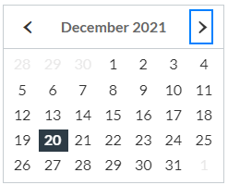
TRANSFER
From account
Select
Checking
To account
Saving
Select
Credit
Amount $
$0.1 – 1000
Schedule for date
01/19/2022
Frequency
Select
Max 2 times/week
Next

Slide 3

TRANSFER
From account
Checking
To account
Saving
Amount $
500.00
$0.1 – 1000
Schedule for date
01/19/2022
Error!
Frequency
Select
Can’t process it. Please check, schedule is not more than 30 days
Max 2 times/week
Back
Next

Slide 4
TRANSFER
From account
Checking
To account
Saving
Amount $
500.00
$0.1 – 1000
Schedule for date
01/19/2022
Frequency
Select
One Time
Max 2 times/week
Weekly
Monthly
Back
Next

Slide 5
TRANSFER
From account
Checking
To account
Saving
Amount $
500.00
$0.1 – 1000
Schedule for date
01/19/2021
Frequency
Today
Max 2 times/week
Error!
Over weekly limit
Back
Next

Slide 6
Review
From account
Checking
To account
Saving
Amount $
$500.00
Schedule for date
12/21/2021
Frequency
Weekly
Back
Next
Cancel

Slide 7
Confirm
From account
Checking
To account
Saving
Amount $
$500.00
Schedule for date
12/21/2021
Frequency
Weekly
Back
Cancel
Confirm

